Slide 1



Lecture Outline
Conditional Probability
A conditional probability is one that is dependent on something before it happens.
What is the probability that it is sunny today given that it rains tomorrow?
Example :

Slide 2

Lecture Outline
Unconditional Probability
An unconditional or independent is one that is unaffected by the previous action.
Example:
What is the probability of a dice rolling a 6?

Slide 3
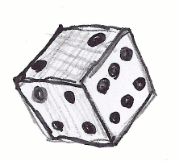
Lecture Outline
Single Event
A simple (or single) event is an event with a single outcome (only one "answer“ is possible).

Slide 4

Lecture Outline
Multiple Event
In probability, when two or more experiments are conducted together.

Slide 5
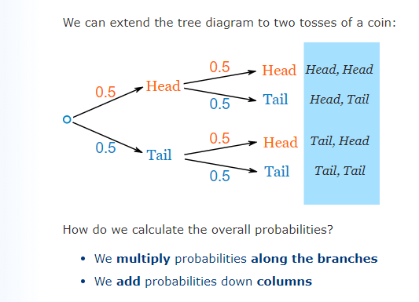
Lecture Outline
Probability Tree

Slide 6
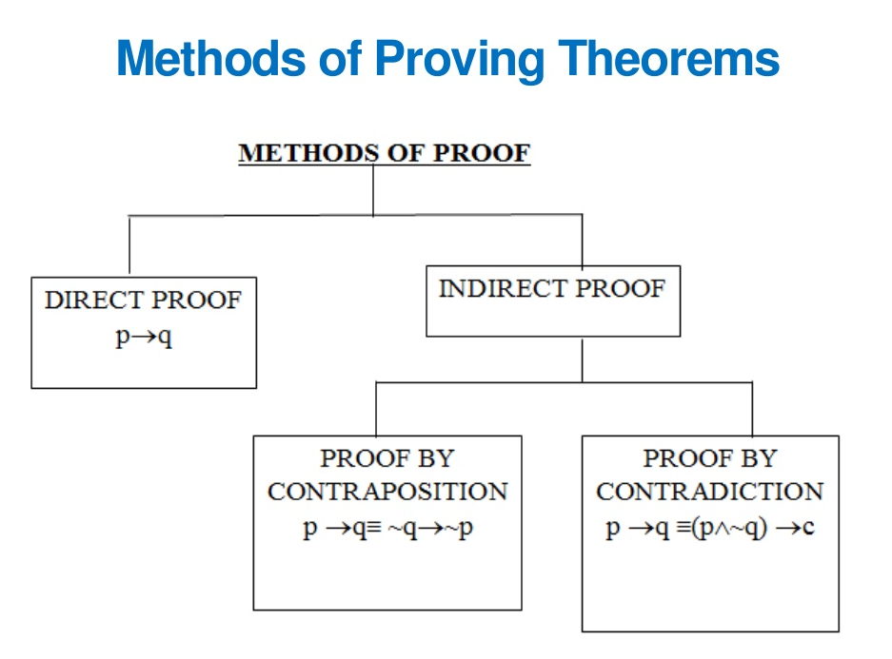
Lecture Outline

Slide 7
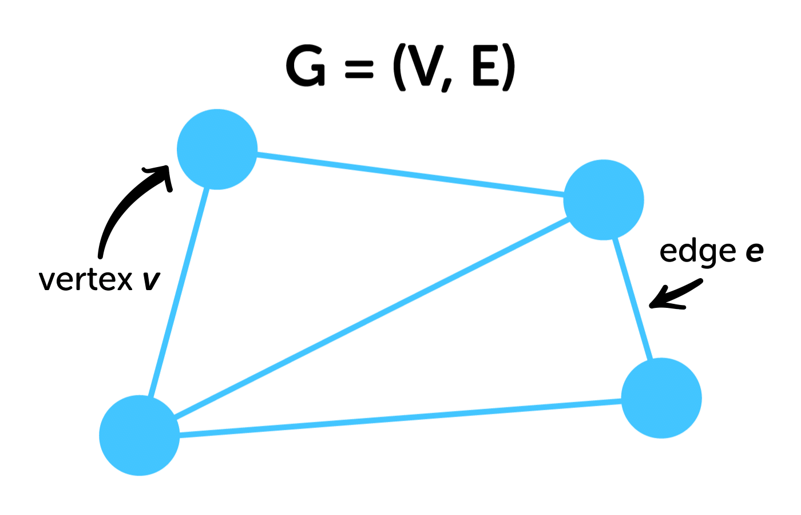
Lecture Outline
Graph
Graph Terminology
Adjacency
Path
Types of graphs
Graph Representation

Slide 8


Tree Examples
Machine learning algorithm.

Slide 9

Tree Examples
In Computer Graphics

Slide 10

Tree Examples
In a chess game to store the defense moves of the player.

Slide 11
Benefits and Need of Trees
An ideal way to go with the hierarchical way of storing data.
Make insertion and deletion faster.
A flexible way of holding and moving data.
Are used to store as many nodes as possible.

Slide 12
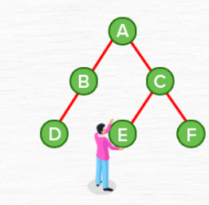

Tree
A tree is a finite nonempty set of elements in which one element is called the root of the tree and the remaining elements are partitioned into disjoint subsets each of which is itself a tree.
Each element in a tree is called a node.

Slide 13
Tree Terminology
Tree terminology is frequently used to describe the relationship between the nodes of the tree.
Any two nodes in a tree can be connected by a single path.

Slide 14
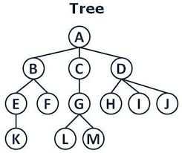
Example of Tree

Slide 15
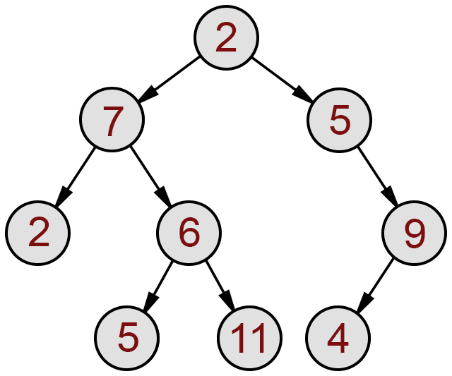
Example of Tree

Slide 16
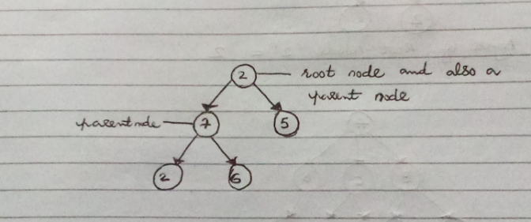
Parent Node
The node which have subtrees is called Parent Node.

Slide 17
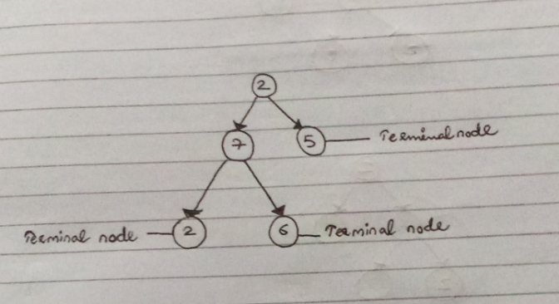
Terminal Node or Leaf Node or External Node
The tree which has no subtree(child) is called terminal node or leaf node.

Slide 18
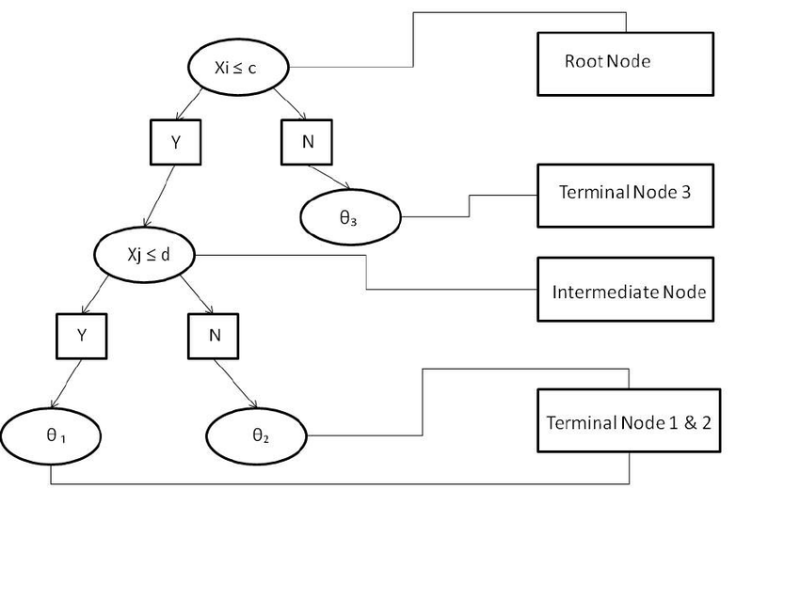
Terminal Node or Leaf Node Example

Slide 19
Branches and Branch Nodes
The lines which are used to connect nodes are called branches.
A branch node or an internal node (also known as an inner node) is any node of a tree that has child nodes.

Slide 20
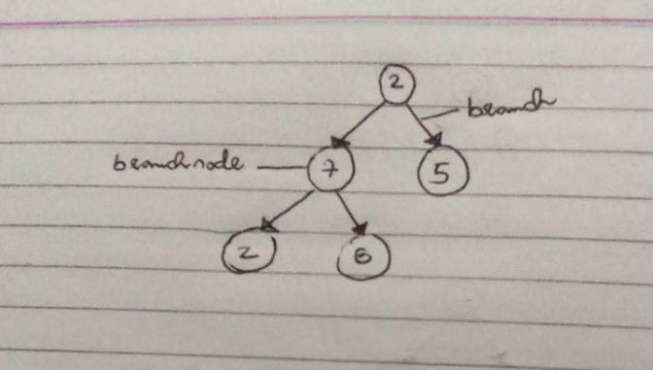
Branches and Branch Nodes Example

Slide 21
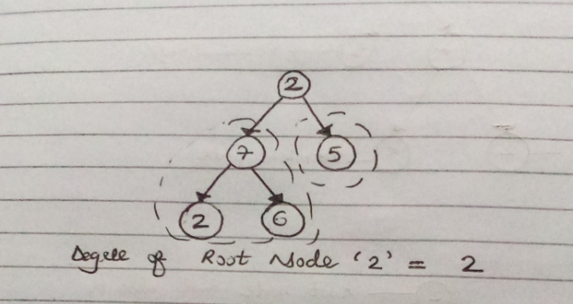
Degree
The degree of the node means number of subtrees of that node(children).

Slide 22
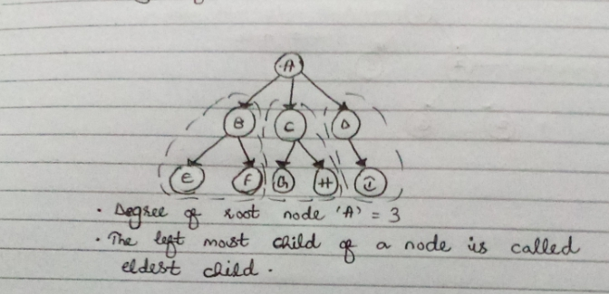
Degree Example

Slide 23
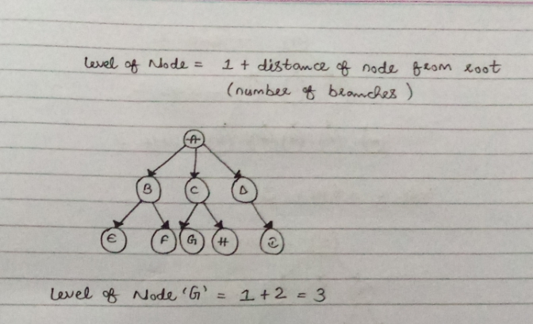
Level of a Node

Slide 24
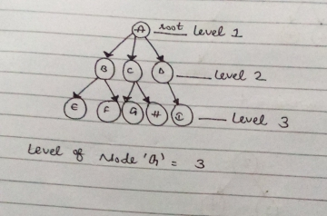
Level of a Node Example

Slide 25
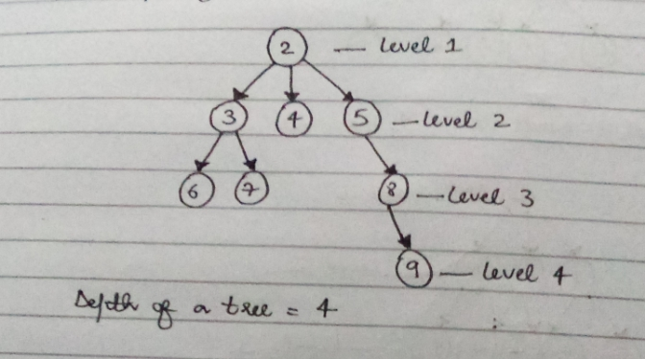
Depth of a Tree
Depth of a Tree = Number of levels

Slide 26
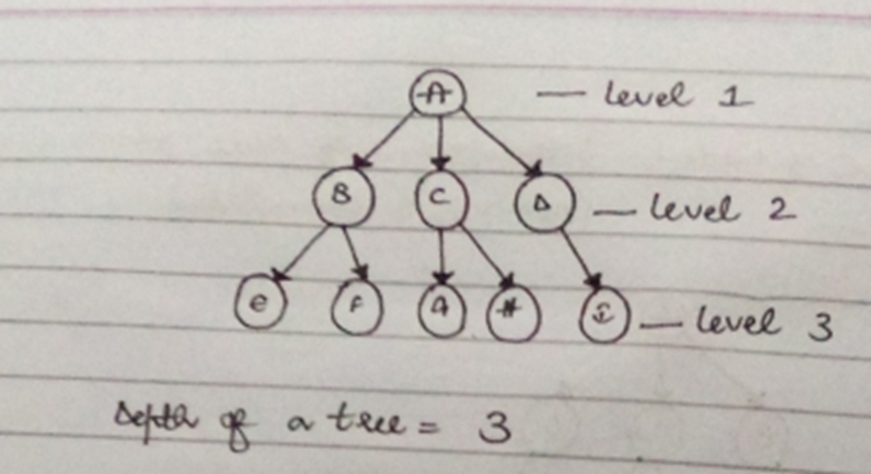
Depth of a Tree Example

Slide 27
Balanced Tree
The tree in which each parent node of a tree has the same number of children(subtrees).

Slide 28
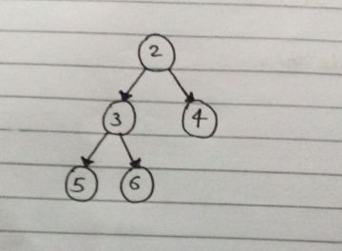
Balanced Tree Example

Slide 29
Unbalanced Tree
A tree in which parent node of tree has the different number of children(subtrees) is called unbalanced tree.

Slide 30
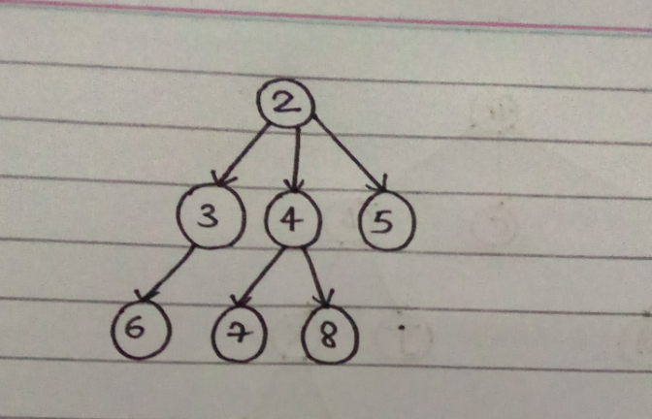
Unbalanced Tree Example

Slide 31
Traversing/Accessing a Tree
There are three possible methods to travers a tree.
Level by Level
Pre-Order(Depth First Order)
Post-Order(Suffix Walk)

Slide 32
1) Level by Level Traversing
Algorithm
Access root node.
Increment level by 1.
Access all nodes from left to right.
Go to step b)
If there is no further level, then end.

Slide 33
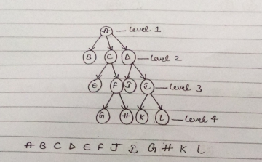
1) Level by Level Traversing Example

Slide 34
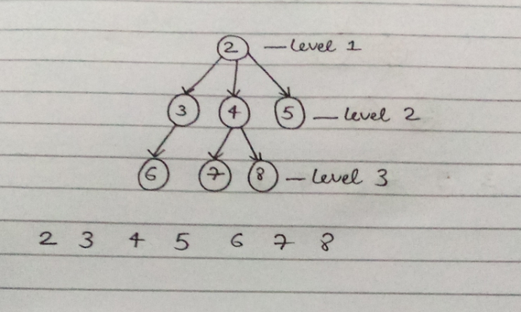
Level by Level Traversing Example

Slide 35
2) Pre-Order Traversing (Depth First Order)
Algorithm
Access root node/Parent node.
If it has a children then access its leftmost child and goto step no c).
If it has a brother then access its twin younger brother then go to step no b).
Go to its parent.
If it’s root then end.

Slide 36
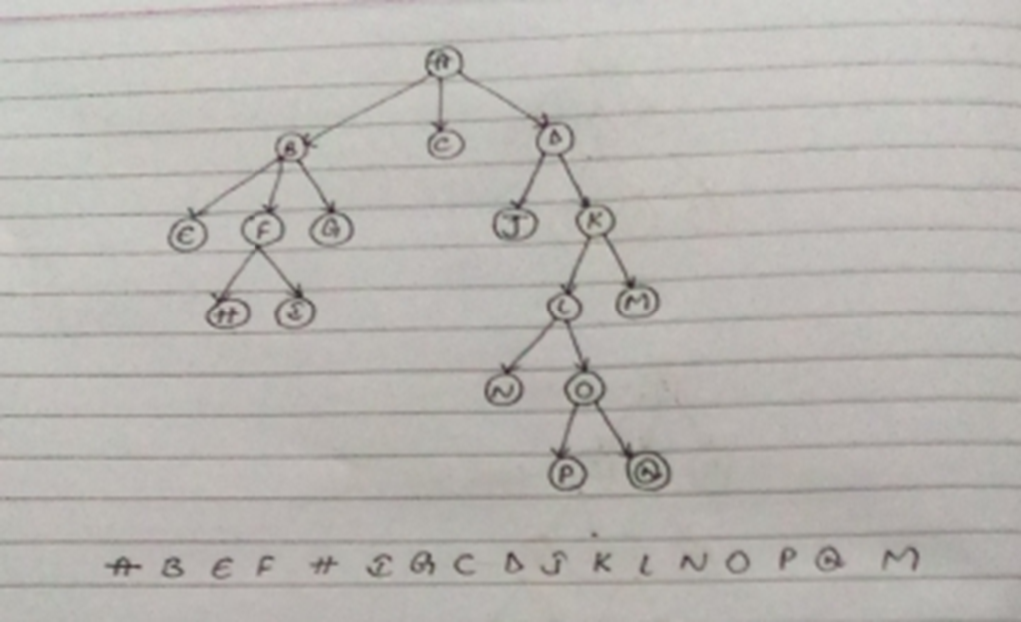
2) Pre-Order Traversing (Depth First Order) Example(PLR)

Slide 37
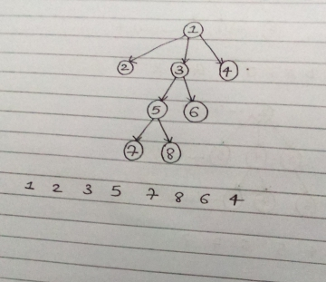
2) Pre-Order Traversing (Depth First Order) Example

Slide 38
3) Post Order Traversing (Suffix Walk)
Algorithm
Go-to Root
If it has children, then go to its left most child and access it
go to step a)
If it has a younger brother then go to its younger brother and go to step no b)
Access its parent
If it is root then end

Slide 39
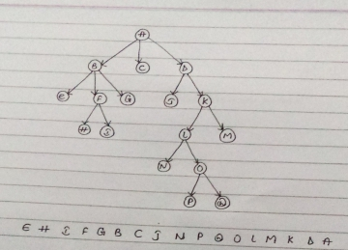
3) Post Order Traversing (Suffix Walk)(LRP) Example

Slide 40
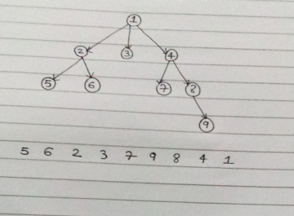
3) Post Order Traversing (Suffix Walk) Example

